Slide 1
School Libraries:
Who? What? Why?
Created by Holly Godfree, Olivia Neilson and Rhonda Bruce
This work is licensed under a Creative Commons Attribution-NonCommercial 4.0 International License.

Slide 2
Overview
Modern School Libraries
The Problem
Some Data
What to Do
(Sivatheesan, 2017)

Slide 3
What do School Libraries
Bring to Mind?
Some people still only think about. . .
Borrowing books
Listening to stories being read
Being shushed
Pixabay
Notes:
Staffing levels have been so bad for so long that many teachers and even principals have never experience what a school library can and should be like. They might think about what it was like when they were in school - which, of course, would not reflect all the behind the scenes work that is so vital for a strong school library service.

Slide 4
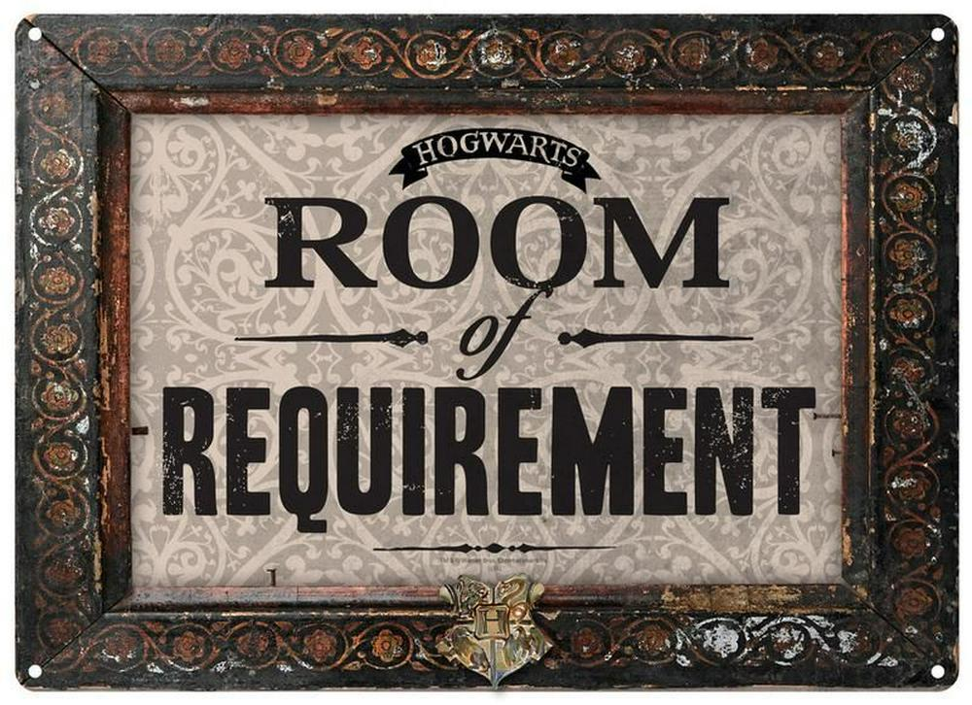
School Libraries are Actually More Like This!
(Half Moon Bay, 2019)

Slide 5
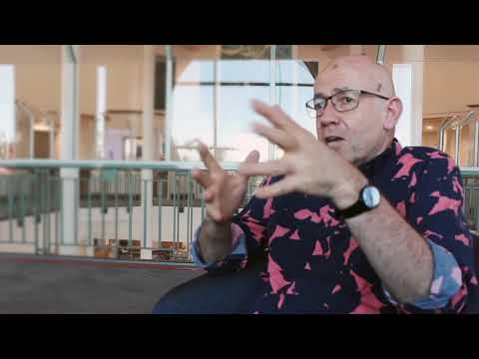
What Do You Learn in a School Library?
Press Ctrl + Click to Play

Slide 6
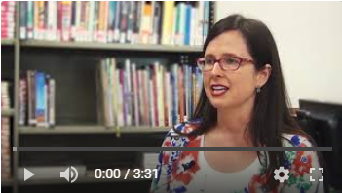
Most Important Factor:
WHO is running the library
The “Right” People:
Are Friendly
Are Organised
Have Qualifications
Watch Teacher? Librarian? Teacher Librarian?

Slide 7
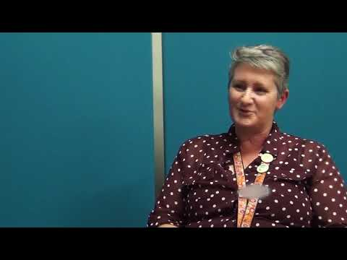
“Digital native” = MYTH!
A toddler with an iPad does not
just naturally “become”
a tech-savvy student
who can investigate a
complex research question.
Wasteson, 2011
Want to know more? Watch Natural Digital Experts

Slide 8
Modern school libraries are about:
Research
Collaboration
Resources
Community

Slide 9
Modern School Libraries = Research
INFORMATION and DIGITAL LITERACY - For school and for life!
Finding, selecting & using good quality information
Note-taking and deep thinking
Referencing
ICT - Using technology well, not just ‘using technology’
Cyber safety
Smart searching
Critical literacy

Slide 10
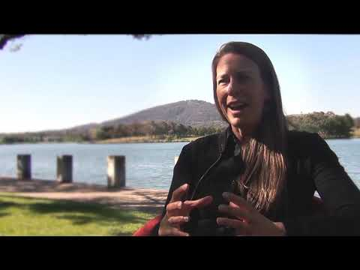
Modern School Libraries = Collaboration
HELPING TEACHERS HELPS STUDENTS
Plan and team teach lessons
Help when people get stuck
Co-design interesting assessments
PERSONALISED SERVICES:
Liaise closely with school leadership
Support differentiation - Special needs, EALD, Giftedness
Want to know more? Watch Teachers + Teacher Librarians = Better Learning
Pixabay

Slide 11
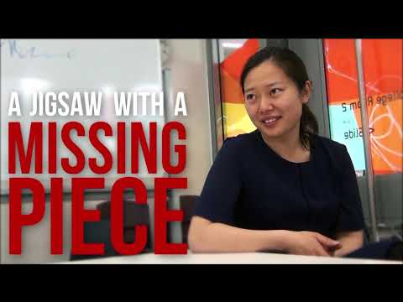
Modern School Libraries = Resources
BUILDING A COLLECTION BEHIND THE SCENES:
Choosing best new physical/digital resources for YOUR school
“Weed” out-of-date resources
Liaise with suppliers
TECHNICAL KNOWLEDGE:
Catalogue records - to find things easily
Borrow / Return / Reserve / Organise
Get it? Libraries save you time!
Pixabay
This one’s a fave: Watch The Pantry Analogy. You won’t regret it!

Slide 12
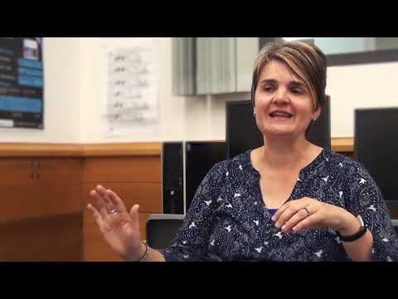
Modern School Libraries = Community
WHEN THE TOUGH TIMES COME...
Welcoming place, Safe haven
Supports mental well-being
Personal connections
The “Third” Space - not classroom, not home
Learning about life through literature
Pixabay
This lovely film is called: School Libraries are a Safe Space

Slide 13
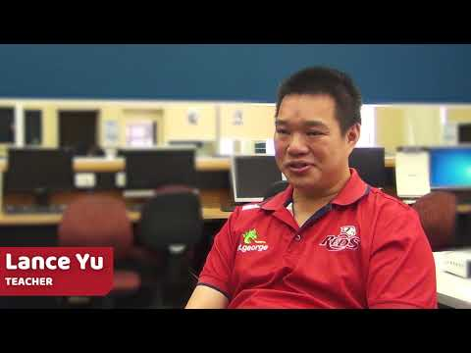
Reading: The bedrock of all learning
Teacher Librarians:
Keep up-to-date with the latest literature
Match books with reluctant readers and keen beans
For more, watch: Fostering a Love of Reading

Slide 14
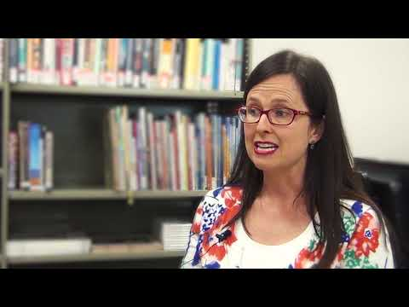
A Strong School Library Needs:
"Right" People (Good social skills & organised)
Qualifications (Essential!)
Team (To provide the full suite of services)
Time (To team teach & organise resources)
Space (Open, welcoming, physical location)
One person alone is not enough...Not convinced? Watch The Library Team.

Slide 15
What the Evidence Says
Qualified teacher librarians have a positive impact on students’ learning, regardless of a child's socio-economic status (Lance & Schwarz, 2012)
Schools with teacher librarians score higher in reading and writing NAPLAN scores (Hughes, 2013)
Teacher librarians identify and effectively support students struggling with reading (Merga, 2019)
Students’ information literacy skills are improved when teacher librarians implement library and information literacy programs (Small, Shanahan & Stasak, 2010)
Pixabay
NOTE: This list barely scratches the surface of the huge amount of research about the positive impact of TLs.

Slide 16
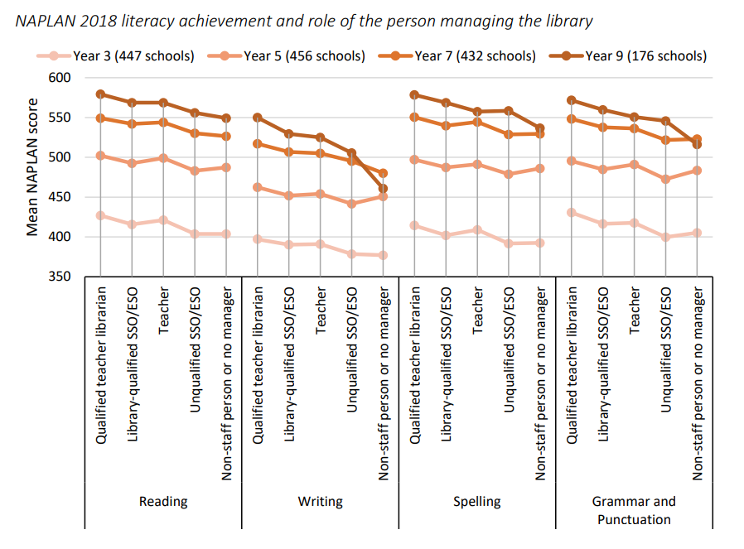
The Problem
Only 23% of Schools have a TL in S.A.
(Dix et al., 2020)

Slide 17
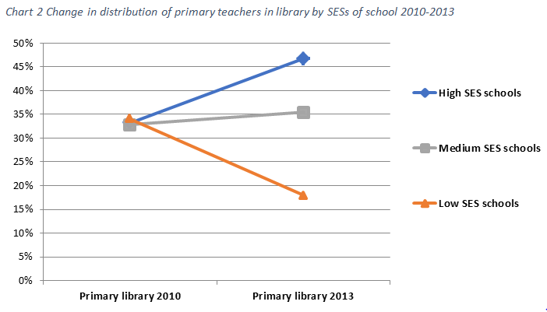
The Problem
Australian Primary School Teachers in Libraries
(Weldon, 2016, p.11)
Notes:
Paul Weldon at ACER

Slide 18
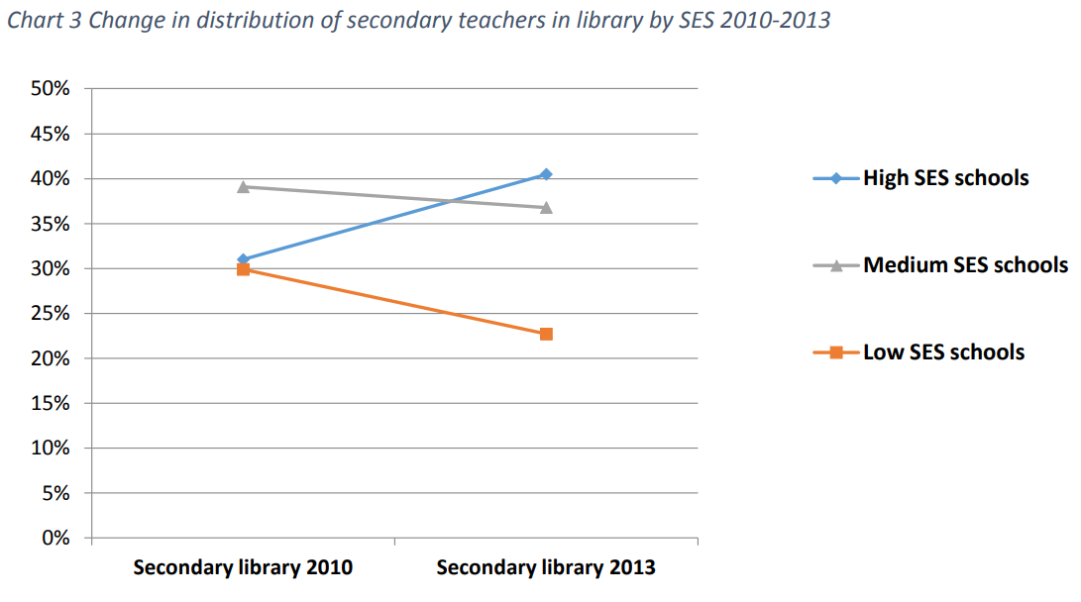
The Problem
Australian Secondary School Teachers in Libraries
(Weldon, 2016, p.11)

Slide 19
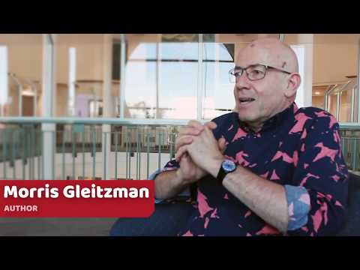
Where to from here?
Watch: Your child's school library
ALL students need a strong school library run by a team of qualified staff.

Slide 20
Ask questions
of your Principal and School Board
What are the qualifications of library staff?
Does the teacher librarian team teach with classroom teachers?
How are information literacy skills taught?
How old is the library collection?
What level of funding is allocated to the library?
What online subscriptions does the library hold?
Pixabay

Slide 21
Talk to Your Child
Can they name several search engines?
Do they use Advanced Search or Boolean search strategies to find information online?
What do they look for on a web page to know the information is trustworthy?
What do they know about using and acknowledging other people's work?
Pixabay

Slide 22
Bigger picture action
Talk to your friends
Connect with the Students Need School Libraries campaign:
Website full of resources
Social media
Newsletter
Talk to or write to politicians:
Education Minister
Local MLAs
Federal Minister for Education
Federal Members of Parliament
Write to the newspaper
Pixabay

Slide 23
References All Pixabay images used under a CC0 public domain license.
Cook, H. (October 16, 2018) Extending the shelf life of the school library in the internet age [article]. Retrieved from https://www.smh.com.au/education/extending-the-shelf-life-of-the-school-library-in-the-internet-age-20181016-p50a9l.html
Dix, K., Felgate, R., Ahmed, S.K., Carslake, T., & Sniedze-Gregory, S. (2020). School libraries in South Australia. 2019 Census. Adelaide, Australia: Australian Council for Educational Research. Retrieved from https://research.acer.edu.au/tll_misc/33/
Ferracane, J. (February 2020). Where have all the School Librarians gone? [article]. Retrieved from https://www.mychildmagazine.com.au/school-librarians-gone
Half Moon Bay. (2019). Harry Potter - Room of Requirement Tin Sign [Image]. Retrieved from https://bit.ly/38W6Crh
House of Representatives. Education and Employment (n.d.) Chapter 3 Potential of school libraries and teacher librarians to contribute to improved educational and community outcomes [Parliamentary Paper]. Retrieved from https://www.aph.gov.au/Parliamentary_Business/Committees/House_of_Representatives_Committees?url=ee/schoollibraries/report/chapter3.htm#anc17
Hughes, H. (2013) School libraries, teacher-librarians and their contribution to student literacy development in Gold Coast schools. SLAQ, Brisbane. Retrieved from https://core.ac.uk/download/pdf/10918219.pdf
Lance, K.C. & Schwarz, B. (2012). How Pennsylvania school libraries pay off: Investments in student achievement and academic standards. Retrieved from http://paschoollibraryproject.org/research
Merga, M. (2019) How do librarians in schools support struggling readers? English in Education, 53(2), 145-160. Retrieved from https://www.tandfonline.com/doi/full/10.1080/04250494.2018.1558030
Sivatheesan, N. (2017). Fly high [Image]. Retrieved from https://goo.gl/ZZmS9T
Small, R.V., Shanahan, K. A. & Stasak, M. (2010). The impact of New York‘s school libraries on student achievement and motivation: Phase III. School Library Research, 13. American Library Association. Retrieved from www.ala.org/aasl/slr/volume13/small-shanahan-stasak
Wasteson, C. (2011). Young Digital Native [Image]. Retrieved from https://bit.ly/2NXvJSl Used under a CC2.0 license.
Weldon, P.R. (2016). What the Staff in Australia’s Schools surveys tell us about teachers working in school libraries. Australian Council for Educational Research (ACER). Retrieved from https://research.acer.edu.au/tll_misc/25/.

Slide 24
https://studentsneedschoollibraries.org.au/
StudentsNeedSchoolLibraries
@NeedSchoolLibs
studentsneedschoollibraries
Join us!

